Slide 1


RAPPER: Ransomware Prevention via Performance Counters
Manaar Alam¹, Sayan Sinha¹, Sarani Bhattacharya¹, Swastika Dutta¹, Debdeep Mukhopadhyay¹,
and Anupam Chattopadhyay²
¹ Department of Computer Science and Engineering, Indian Institute of Technology Kharagpur
² School of Computer Science and Engineering, Nanyang Technological University Singapore
7th December, 2018, Adelaide, Australia
Kangacrypt 2018: Australian Workshop on Offensive Cryptography

Slide 2
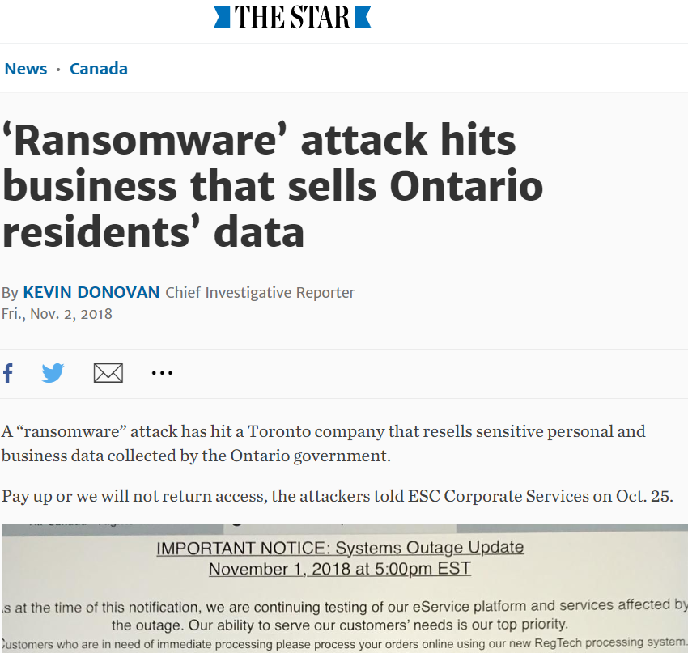
Recent News
Image Source: Google Image

Slide 3
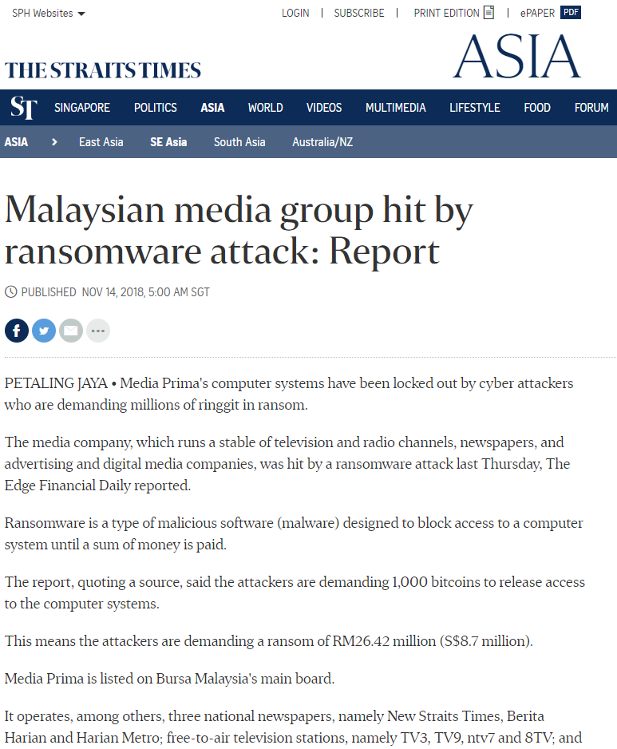
Recent News
Image Source: Google Image

Slide 4
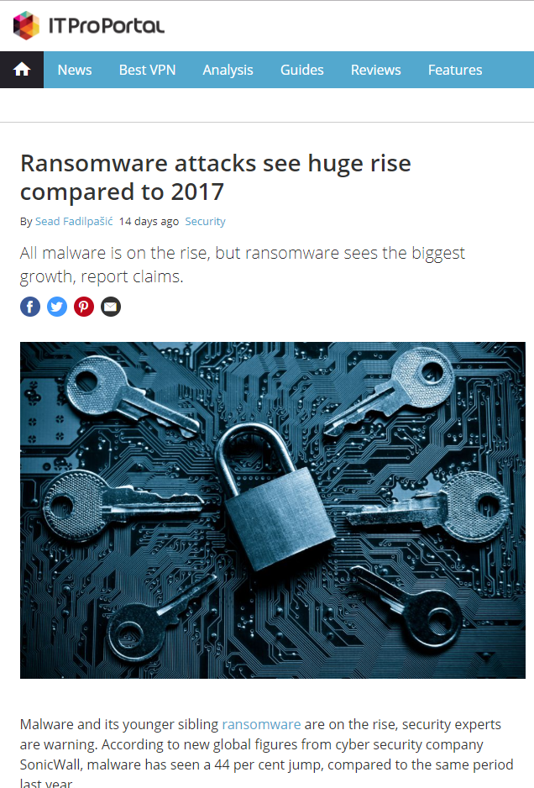
Recent News
Image Source: Google Image

Slide 5
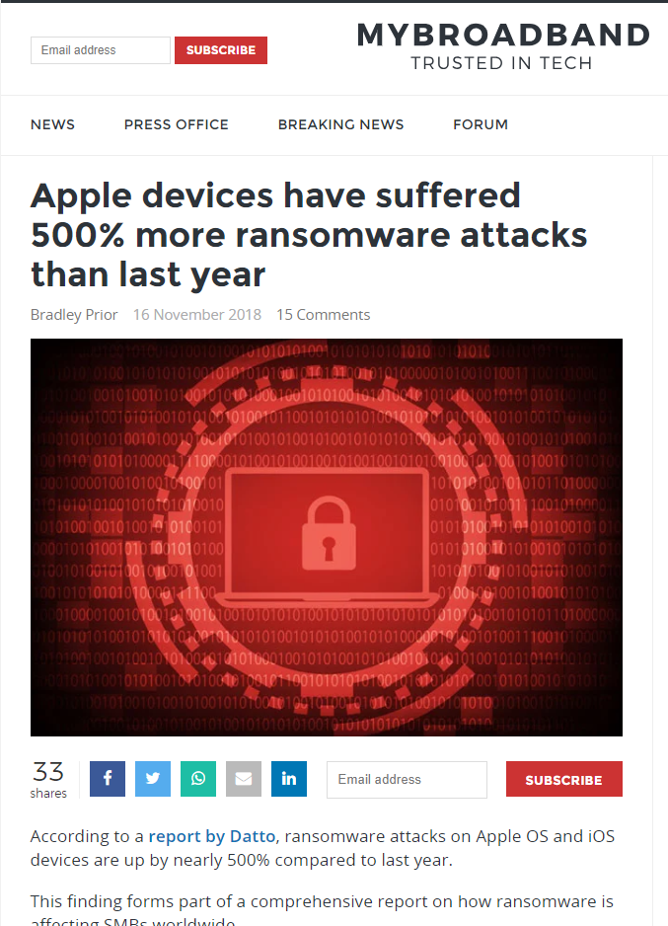
Recent News
Image Source: Google Image

Slide 6
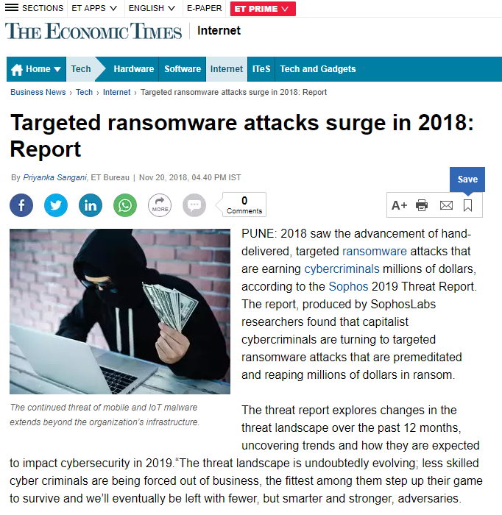
Recent News
Image Source: Google Image

Slide 7
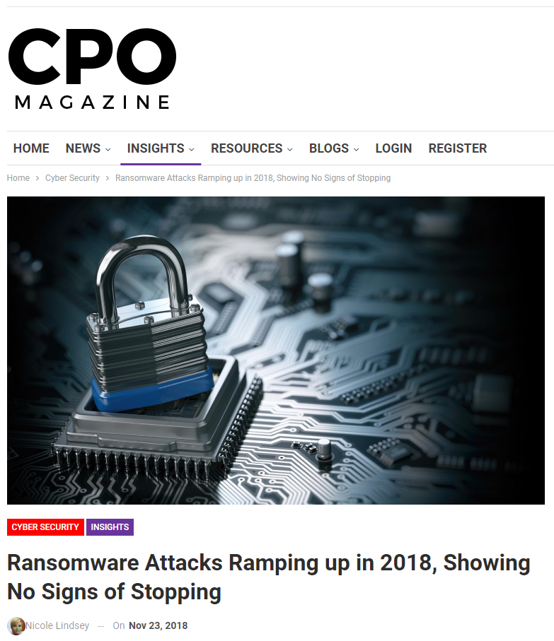
Recent News
Image Source: Google Image

Slide 8
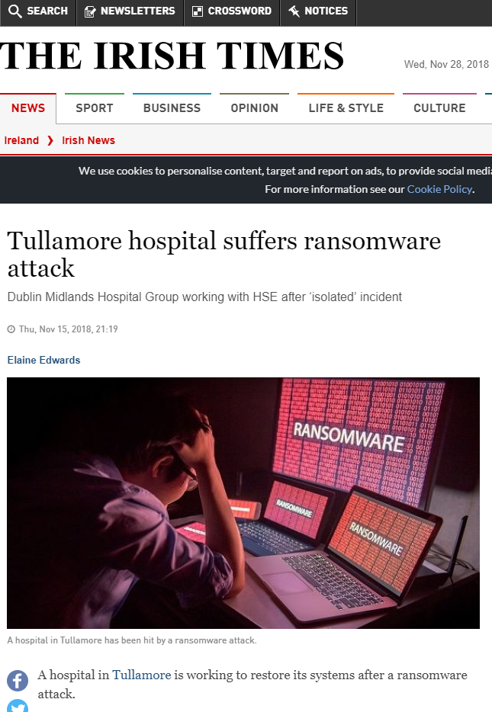
Recent News
Image Source: Google Image

Slide 9
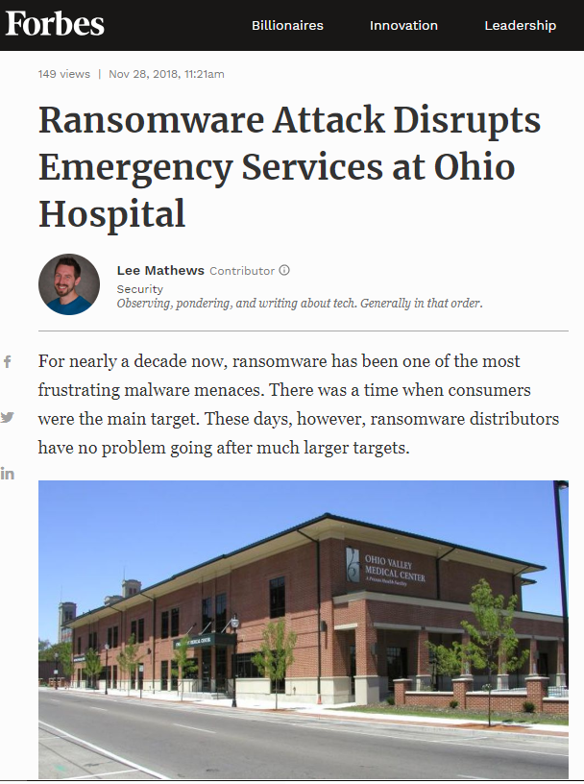
Recent News
Image Source: Google Image

Slide 10
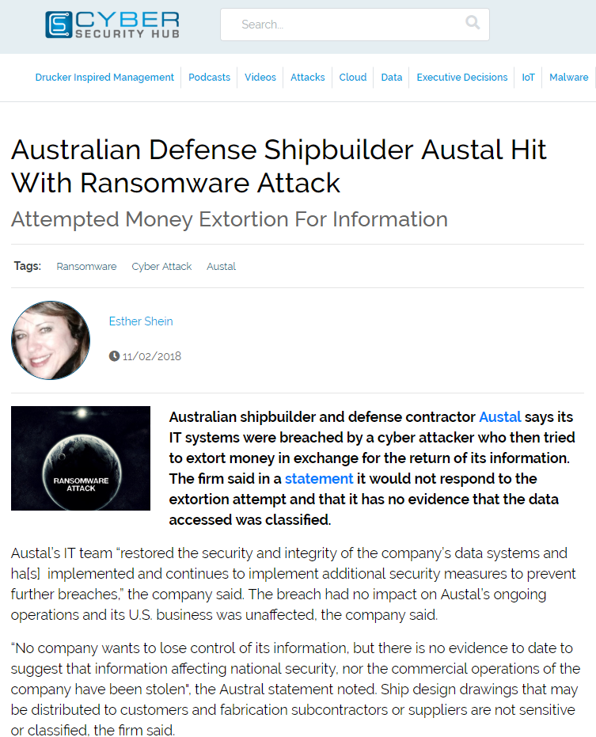
Recent News
Image Source: Google Image

Slide 11
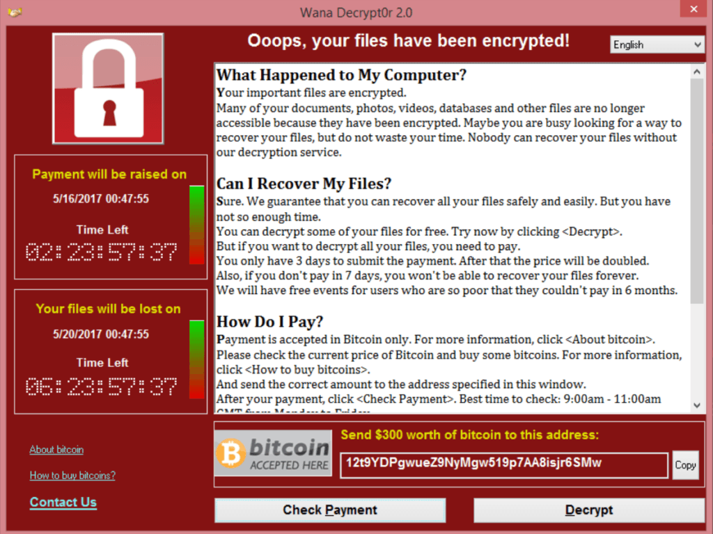
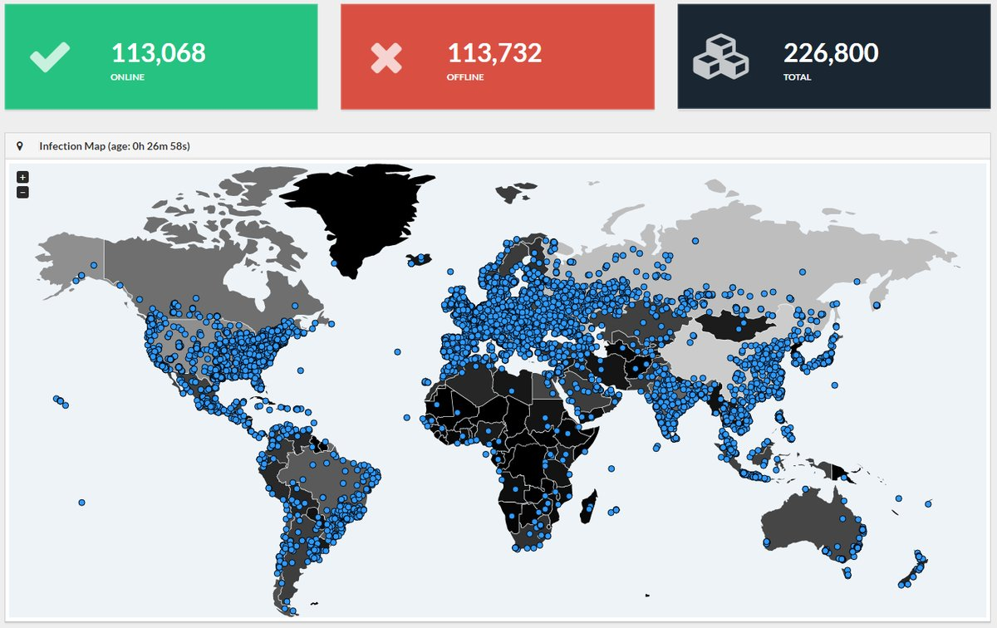
Threat of WannaCry
One of the most familiar images of 2017
In May 2017, WannaCry ransomware has affected approximately 200,000 business across 150 countries.
Image Source: Google Image

Slide 12









Damages by WannaCry
Up to 70,000 devices - including computers, MRI scanners, blood-storage refrigerators and theatre equipment of National Health Service hospitals in England and Scotland and have been affected.
Nissan Motor Manufacturing UK in Tyne and Wear, England, halted production after the ransomware infected some of their systems.
According to Cyber risk modelling firm Cyence, economic losses from the cyber attack could reach up to $4 billion.
And many more........
Image Source: Google Image

Slide 13



What is a Ransomware??
Ransomware is a type of malicious software from cryptovirology that encrypts certain file types on infected systems and forces users to pay the ransom through certain online payment methods to get a decrypt key.
Image Source: Google Image

Slide 14
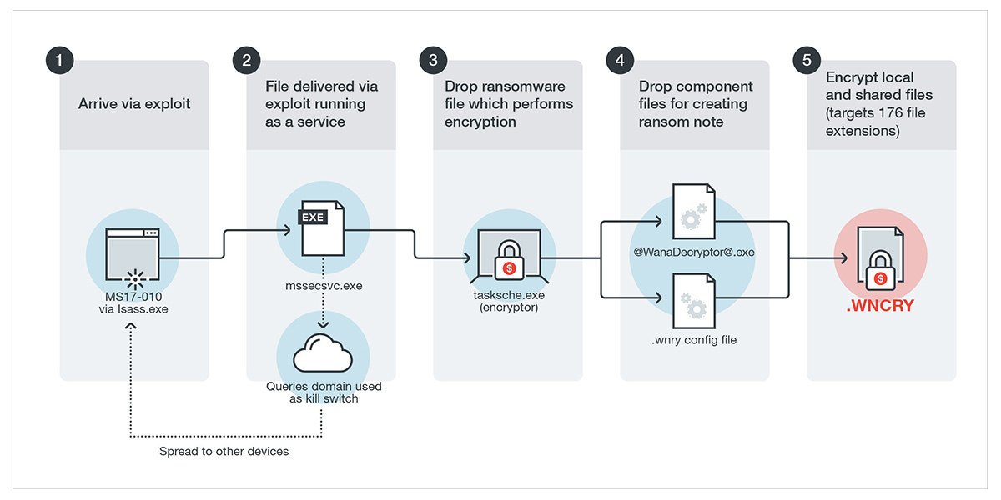
What is a Ransomware??
Ransomware is a type of malicious software from cryptovirology that encrypts certain file types on infected systems and forces users to pay the ransom through certain online payment methods to get a decrypt key.
Image Source: Google Image

Slide 15
Why their Detection is Important??
Detection Schemes

Slide 16
Why their Detection is Important??
Detection Schemes
Static Analysis

Slide 17
Why their Detection is Important??
Detection Schemes
Static Analysis
Unknown new Ransomwares could easily bypass this scheme of detection.

Slide 18
Why their Detection is Important??
Detection Schemes
Static Analysis
Behavioral Analysis
Unknown new Ransomwares could easily bypass this scheme of detection.

Slide 19
Why their Detection is Important??
Detection Schemes
Static Analysis
Behavioral Analysis
Unknown new Ransomwares could easily bypass this scheme of detection.
Existence of large false positives and false negatives.

Slide 20
Why their Detection is Important??
Detection Schemes
Static Analysis
Behavioral Analysis
Unknown new Ransomwares could easily bypass this scheme of detection.
Existence of large false positives and false negatives.
The occurrences of newer varieties of ransomwares and their nature proves that the designing of a generalised detection mechanism is an extremely difficult problem.

Slide 21
Observing System Behavior using HPC
Hardware Performance Counters
Set of special purpose registers, present in most of the microprocessor's Performance Monitoring Unit (PMU).
Store hardware and software events related to the execution of a program, such as cache misses, retired instructions, retired branch instructions, etc.
Type and number of hardware events vary across different Instruction Set Architectures (ISA).
Various open-source tools can measure this HPC values: perf tools, PAPI, OProfile, Valgrind and many more.

Slide 22
Observing System Behavior using HPC
Linux perf tool
Perf is a profiler tool for Linux 2.6.31+ based systems that presents a simple command line interface to collect and analyze performance counter statistics.
A user can observe the performance counters associated with a system with some time interval, thereby giving the benefit of observing the system behavior continuously in a succession of time.

Slide 23
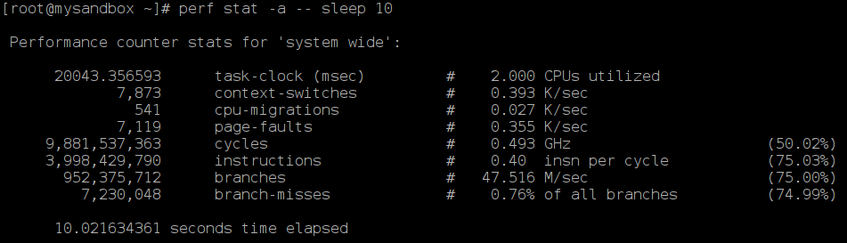
Observing System Behavior using HPC
Linux perf tool
Perf is a profiler tool for Linux 2.6.31+ based systems that presents a simple command line interface to collect and analyze performance counter statistics.
A user can observe the performance counters associated with a system with some time interval, thereby giving the benefit of observing the system behavior continuously in a succession of time.
perf stat -e <event_name> -I <time_interval> <executable_name>

Slide 24
Observing System Behavior using HPC
Linux perf tool
Perf is a profiler tool for Linux 2.6.31+ based systems that presents a simple command line interface to collect and analyze performance counter statistics.
A user can observe the performance counters associated with a system with some time interval, thereby giving the benefit of observing the system behavior continuously in a succession of time.
Events
perf stat -e <event_name> -I <time_interval> <executable_name>

Slide 25
Observing System Behavior using HPC
Linux perf tool
Perf is a profiler tool for Linux 2.6.31+ based systems that presents a simple command line interface to collect and analyze performance counter statistics.
A user can observe the performance counters associated with a system with some time interval, thereby giving the benefit of observing the system behavior continuously in a succession of time.
Values
Events
perf stat -e <event_name> -I <time_interval> <executable_name>

Slide 26
Recent Efforts in Detecting Ransomwares
Kharraz, A., Robertson, W., Balzarotti, D., Bilge, L., Kirda, E., “Cutting the gordian knot: A look under the hood of ransomware attacks”, in 12th Conference on Detection of Intrusions and Malware & Vulnerability Assessment, July 2015, Milan, Italy.

Slide 27
Recent Efforts in Detecting Ransomwares
Kharraz, A., Robertson, W., Balzarotti, D., Bilge, L., Kirda, E., “Cutting the gordian knot: A look under the hood of ransomware attacks”, in 12th Conference on Detection of Intrusions and Malware & Vulnerability Assessment, July 2015, Milan, Italy.
Showed ransomwares leave a trait in the access of I/O and file-systems

Slide 28
Recent Efforts in Detecting Ransomwares
Kharraz, A., Robertson, W., Balzarotti, D., Bilge, L., Kirda, E., “Cutting the gordian knot: A look under the hood of ransomware attacks”, in 12th Conference on Detection of Intrusions and Malware & Vulnerability Assessment, July 2015, Milan, Italy.
Kharraz, A., Arshad, S., Mulliner, C., Robertson, W., Kirda, E., “UNVEIL: A largescale, automated approach to detecting ransomware”, in 25th USENIX Security Symposium, August 2016, Austin, Texas.

Slide 29
Recent Efforts in Detecting Ransomwares
Kharraz, A., Robertson, W., Balzarotti, D., Bilge, L., Kirda, E., “Cutting the gordian knot: A look under the hood of ransomware attacks”, in 12th Conference on Detection of Intrusions and Malware & Vulnerability Assessment, July 2015, Milan, Italy.
Kharraz, A., Arshad, S., Mulliner, C., Robertson, W., Kirda, E., “UNVEIL: A largescale, automated approach to detecting ransomware”, in 25th USENIX Security Symposium, August 2016, Austin, Texas.
Correlates high file system activities with the intrusion of ransomwares

Slide 30
Recent Efforts in Detecting Ransomwares
Kharraz, A., Robertson, W., Balzarotti, D., Bilge, L., Kirda, E., “Cutting the gordian knot: A look under the hood of ransomware attacks”, in 12th Conference on Detection of Intrusions and Malware & Vulnerability Assessment, July 2015, Milan, Italy.
Kharraz, A., Arshad, S., Mulliner, C., Robertson, W., Kirda, E., “UNVEIL: A largescale, automated approach to detecting ransomware”, in 25th USENIX Security Symposium, August 2016, Austin, Texas.
Susceptible to false positives and can be defeated with a slow encryption process

Slide 31
Recent Efforts in Detecting Ransomwares
Kharraz, A., Robertson, W., Balzarotti, D., Bilge, L., Kirda, E., “Cutting the gordian knot: A look under the hood of ransomware attacks”, in 12th Conference on Detection of Intrusions and Malware & Vulnerability Assessment, July 2015, Milan, Italy.
Kharraz, A., Arshad, S., Mulliner, C., Robertson, W., Kirda, E., “UNVEIL: A largescale, automated approach to detecting ransomware”, in 25th USENIX Security Symposium, August 2016, Austin, Texas.
Requires modification in OS kernel, which may not be practical in many real-life scenarios

Slide 32
Recent Efforts in Detecting Ransomwares
Kharraz, A., Robertson, W., Balzarotti, D., Bilge, L., Kirda, E., “Cutting the gordian knot: A look under the hood of ransomware attacks”, in 12th Conference on Detection of Intrusions and Malware & Vulnerability Assessment, July 2015, Milan, Italy.
Kharraz, A., Arshad, S., Mulliner, C., Robertson, W., Kirda, E., “UNVEIL: A largescale, automated approach to detecting ransomware”, in 25th USENIX Security Symposium, August 2016, Austin, Texas.
Mercaldo, V. Nardone, A. Santone, and C. A. Visaggio, “Ransomware steals your phone. formal methods rescue it,” in International Conference on Formal Techniques for Distributed Objects, Components, and Systems. Springer, 2016, pp. 212–221.

Slide 33
Recent Efforts in Detecting Ransomwares
Kharraz, A., Robertson, W., Balzarotti, D., Bilge, L., Kirda, E., “Cutting the gordian knot: A look under the hood of ransomware attacks”, in 12th Conference on Detection of Intrusions and Malware & Vulnerability Assessment, July 2015, Milan, Italy.
Kharraz, A., Arshad, S., Mulliner, C., Robertson, W., Kirda, E., “UNVEIL: A largescale, automated approach to detecting ransomware”, in 25th USENIX Security Symposium, August 2016, Austin, Texas.
Mercaldo, V. Nardone, A. Santone, and C. A. Visaggio, “Ransomware steals your phone. formal methods rescue it,” in International Conference on Formal Techniques for Distributed Objects, Components, and Systems. Springer, 2016, pp. 212–221.
High in False Positives

Slide 34
Recent Efforts in Detecting Ransomwares
Kharraz, A., Robertson, W., Balzarotti, D., Bilge, L., Kirda, E., “Cutting the gordian knot: A look under the hood of ransomware attacks”, in 12th Conference on Detection of Intrusions and Malware & Vulnerability Assessment, July 2015, Milan, Italy.
Kharraz, A., Arshad, S., Mulliner, C., Robertson, W., Kirda, E., “UNVEIL: A largescale, automated approach to detecting ransomware”, in 25th USENIX Security Symposium, August 2016, Austin, Texas.
Mercaldo, V. Nardone, A. Santone, and C. A. Visaggio, “Ransomware steals your phone. formal methods rescue it,” in International Conference on Formal Techniques for Distributed Objects, Components, and Systems. Springer, 2016, pp. 212–221.
C. Moore, “Detecting ransomware with honeypot techniques,” in Cyber-security and Cyberforensics Conference (CCC), 2016. IEEE, 2016, pp.77–81.

Slide 35
Recent Efforts in Detecting Ransomwares
Kharraz, A., Robertson, W., Balzarotti, D., Bilge, L., Kirda, E., “Cutting the gordian knot: A look under the hood of ransomware attacks”, in 12th Conference on Detection of Intrusions and Malware & Vulnerability Assessment, July 2015, Milan, Italy.
Kharraz, A., Arshad, S., Mulliner, C., Robertson, W., Kirda, E., “UNVEIL: A largescale, automated approach to detecting ransomware”, in 25th USENIX Security Symposium, August 2016, Austin, Texas.
Mercaldo, V. Nardone, A. Santone, and C. A. Visaggio, “Ransomware steals your phone. formal methods rescue it,” in International Conference on Formal Techniques for Distributed Objects, Components, and Systems. Springer, 2016, pp. 212–221.
C. Moore, “Detecting ransomware with honeypot techniques,” in Cyber-security and Cyberforensics Conference (CCC), 2016. IEEE, 2016, pp.77–81.
Can be bypassed if honeypot bait is not taken

Slide 36
Recent Efforts in Detecting Ransomwares
Kharraz, A., Robertson, W., Balzarotti, D., Bilge, L., Kirda, E., “Cutting the gordian knot: A look under the hood of ransomware attacks”, in 12th Conference on Detection of Intrusions and Malware & Vulnerability Assessment, July 2015, Milan, Italy.
Kharraz, A., Arshad, S., Mulliner, C., Robertson, W., Kirda, E., “UNVEIL: A largescale, automated approach to detecting ransomware”, in 25th USENIX Security Symposium, August 2016, Austin, Texas.
Mercaldo, V. Nardone, A. Santone, and C. A. Visaggio, “Ransomware steals your phone. formal methods rescue it,” in International Conference on Formal Techniques for Distributed Objects, Components, and Systems. Springer, 2016, pp. 212–221.
C. Moore, “Detecting ransomware with honeypot techniques,” in Cyber-security and Cyberforensics Conference (CCC), 2016. IEEE, 2016, pp.77–81.
N. Scaife, H. Carter, P. Traynor, and K. R. Butler, “Cryptolock (and dropit): stopping ransomware attacks on user data,” in Distributed Computing Systems (ICDCS), 2016 IEEE 36th International Conference on. IEEE, 2016, pp. 303–312

Slide 37
Recent Efforts in Detecting Ransomwares
Kharraz, A., Robertson, W., Balzarotti, D., Bilge, L., Kirda, E., “Cutting the gordian knot: A look under the hood of ransomware attacks”, in 12th Conference on Detection of Intrusions and Malware & Vulnerability Assessment, July 2015, Milan, Italy.
Kharraz, A., Arshad, S., Mulliner, C., Robertson, W., Kirda, E., “UNVEIL: A largescale, automated approach to detecting ransomware”, in 25th USENIX Security Symposium, August 2016, Austin, Texas.
Mercaldo, V. Nardone, A. Santone, and C. A. Visaggio, “Ransomware steals your phone. formal methods rescue it,” in International Conference on Formal Techniques for Distributed Objects, Components, and Systems. Springer, 2016, pp. 212–221.
C. Moore, “Detecting ransomware with honeypot techniques,” in Cyber-security and Cyberforensics Conference (CCC), 2016. IEEE, 2016, pp.77–81.
N. Scaife, H. Carter, P. Traynor, and K. R. Butler, “Cryptolock (and dropit): stopping ransomware attacks on user data,” in Distributed Computing Systems (ICDCS), 2016 IEEE 36th International Conference on. IEEE, 2016, pp. 303–312
Needs Kernel Level modifications to detect ransomwares

Slide 38
Recent Efforts in Detecting Ransomwares
Kharraz, A., Robertson, W., Balzarotti, D., Bilge, L., Kirda, E., “Cutting the gordian knot: A look under the hood of ransomware attacks”, in 12th Conference on Detection of Intrusions and Malware & Vulnerability Assessment, July 2015, Milan, Italy.
Kharraz, A., Arshad, S., Mulliner, C., Robertson, W., Kirda, E., “UNVEIL: A largescale, automated approach to detecting ransomware”, in 25th USENIX Security Symposium, August 2016, Austin, Texas.
Mercaldo, V. Nardone, A. Santone, and C. A. Visaggio, “Ransomware steals your phone. formal methods rescue it,” in International Conference on Formal Techniques for Distributed Objects, Components, and Systems. Springer, 2016, pp. 212–221.
C. Moore, “Detecting ransomware with honeypot techniques,” in Cyber-security and Cyberforensics Conference (CCC), 2016. IEEE, 2016, pp.77–81.
N. Scaife, H. Carter, P. Traynor, and K. R. Butler, “Cryptolock (and dropit): stopping ransomware attacks on user data,” in Distributed Computing Systems (ICDCS), 2016 IEEE 36th International Conference on. IEEE, 2016, pp. 303–312
Kiraz, M.S., Genç, Z.A., Öztürk, E., “Detecting large integer arithmetic for defense against crypto ransomware”, in Cryptology ePrint Archive, Report 2017/558 (2017).
Lestringant, P., Guihéry, F., Fouque, P.A., “Automated identification of cryptographic primitives in binary code with data flow graph isomorphism”, in 10th ACM Symposium on Information, Computer and Communications Security, April 2015, Singapore.
Gröbert, F., Willems, C., Holz, T., “Automated Identification of Cryptographic Primitives in Binary Programs”, in 14th International Symposium on Recent Advances in Intrusion Detection, September 2011, California, USA.

Slide 39
Recent Efforts in Detecting Ransomwares
Kharraz, A., Robertson, W., Balzarotti, D., Bilge, L., Kirda, E., “Cutting the gordian knot: A look under the hood of ransomware attacks”, in 12th Conference on Detection of Intrusions and Malware & Vulnerability Assessment, July 2015, Milan, Italy.
Kharraz, A., Arshad, S., Mulliner, C., Robertson, W., Kirda, E., “UNVEIL: A largescale, automated approach to detecting ransomware”, in 25th USENIX Security Symposium, August 2016, Austin, Texas.
Mercaldo, V. Nardone, A. Santone, and C. A. Visaggio, “Ransomware steals your phone. formal methods rescue it,” in International Conference on Formal Techniques for Distributed Objects, Components, and Systems. Springer, 2016, pp. 212–221.
C. Moore, “Detecting ransomware with honeypot techniques,” in Cyber-security and Cyberforensics Conference (CCC), 2016. IEEE, 2016, pp.77–81.
N. Scaife, H. Carter, P. Traynor, and K. R. Butler, “Cryptolock (and dropit): stopping ransomware attacks on user data,” in Distributed Computing Systems (ICDCS), 2016 IEEE 36th International Conference on. IEEE, 2016, pp. 303–312
Kiraz, M.S., Genç, Z.A., Öztürk, E., “Detecting large integer arithmetic for defense against crypto ransomware”, in Cryptology ePrint Archive, Report 2017/558 (2017).
Lestringant, P., Guihéry, F., Fouque, P.A., “Automated identification of cryptographic primitives in binary code with data flow graph isomorphism”, in 10th ACM Symposium on Information, Computer and Communications Security, April 2015, Singapore.
Gröbert, F., Willems, C., Holz, T., “Automated Identification of Cryptographic Primitives in Binary Programs”, in 14th International Symposium on Recent Advances in Intrusion Detection, September 2011, California, USA.
Target a specific family of ransomwares

Slide 40
Our Contribution
We propose a comprehensive ransomware detection methodology using the Hardware Performance Counters (HPCs), which helps us to obtain valuable information, with finer granularity, related to different ransomwares and thereby helps us to devise a method to detect and prevent ransomwares with minimal detection latency.
We propose an unsupervised learning technique with the help of an LSTM-based Autoencoder. The advantage is that we do not require a labeled dataset, which is often difficult to obtain considering the occurrences of several newer unknown varieties of ransomwares, and the detection of unknown ransomware is far greater challenge than known ones.
We utilize the repetitive property of ransomwares in our detection framework. The repeated pattern of ransomware executables can be detected on the frequency domain. Thus, we proposed to use another LSTM-based Autoencoder trained on the values obtained by applying Fast Fourier Transformation (FFT) on the time-domain performance counter data for normal observation.
We also explore the performance of the method in presence of popular Disk Encryption programs, and devise a correlation based approach to differentiate between these two processes and get rid of false positives.

Slide 41
Does Ransomware affect the Performance Counters??
We designed a watchdog program and observed five performance counters (in sampling mode) which are likely to be affected by Ransomware (because of its repeated encryption of files).

Slide 42
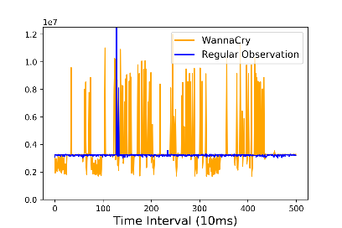
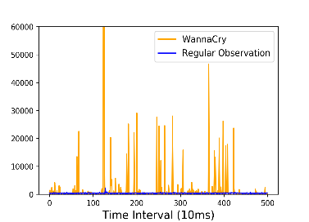
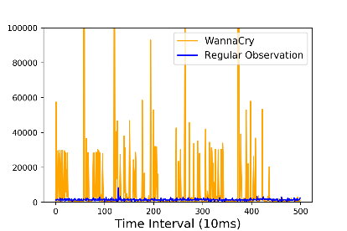
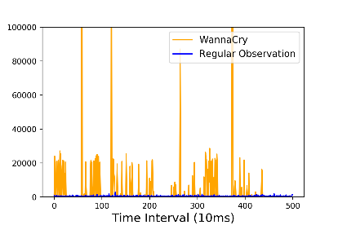
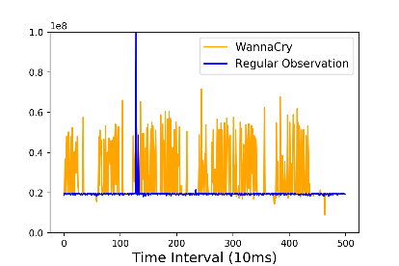
Does Ransomware affect the Performance Counters??
We designed a watchdog program and observed five performance counters (in sampling mode) which are likely to be affected by Ransomware (because of its repeated encryption of files).
Branch Instructions
Branch Misses
Cache References
Cache Misses
Instructions

Slide 43
Does Ransomware affect the Performance Counters??
We designed a watchdog program and observed five performance counters (in sampling mode) which are likely to be affected by Ransomware (because of its repeated encryption of files).
We do not measure performance counter events for any ransomware executables. We executed them in the background for more realistic scenario.
Branch Instructions
Branch Misses
Cache References
Cache Misses
Instructions

Slide 44
Does Ransomware affect the Performance Counters??
We designed a watchdog program and observed five performance counters (in sampling mode) which are likely to be affected by Ransomware (because of its repeated encryption of files).
We do not measure performance counter events for any ransomware executables. We executed them in the background for more realistic scenario.
YES
Ransomwares do affect these events
Branch Instructions
Branch Misses
Cache References
Cache Misses
Instructions

Slide 45
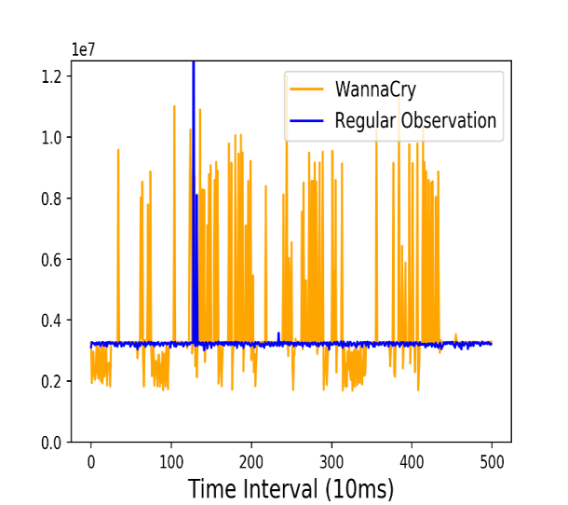
Is it enough to observe a single sample point??
Branch Instructions

Slide 46
Is it enough to observe a single sample point??
Branch Instructions
Can not differentiate by observing a single point

Slide 47
Is it enough to observe a single sample point??
Branch Instructions
Branch Instructions
Can not differentiate by observing a single point
The difference is more clear within a specific window

Slide 48
Is it enough to observe a single sample point??
It is better to consider the performance counter values as multivariate time-series sequence of specific window size instead of single feature point.
Branch Instructions
Branch Instructions
Can not differentiate by observing a single point
The difference is more clear within a specific window

Slide 49
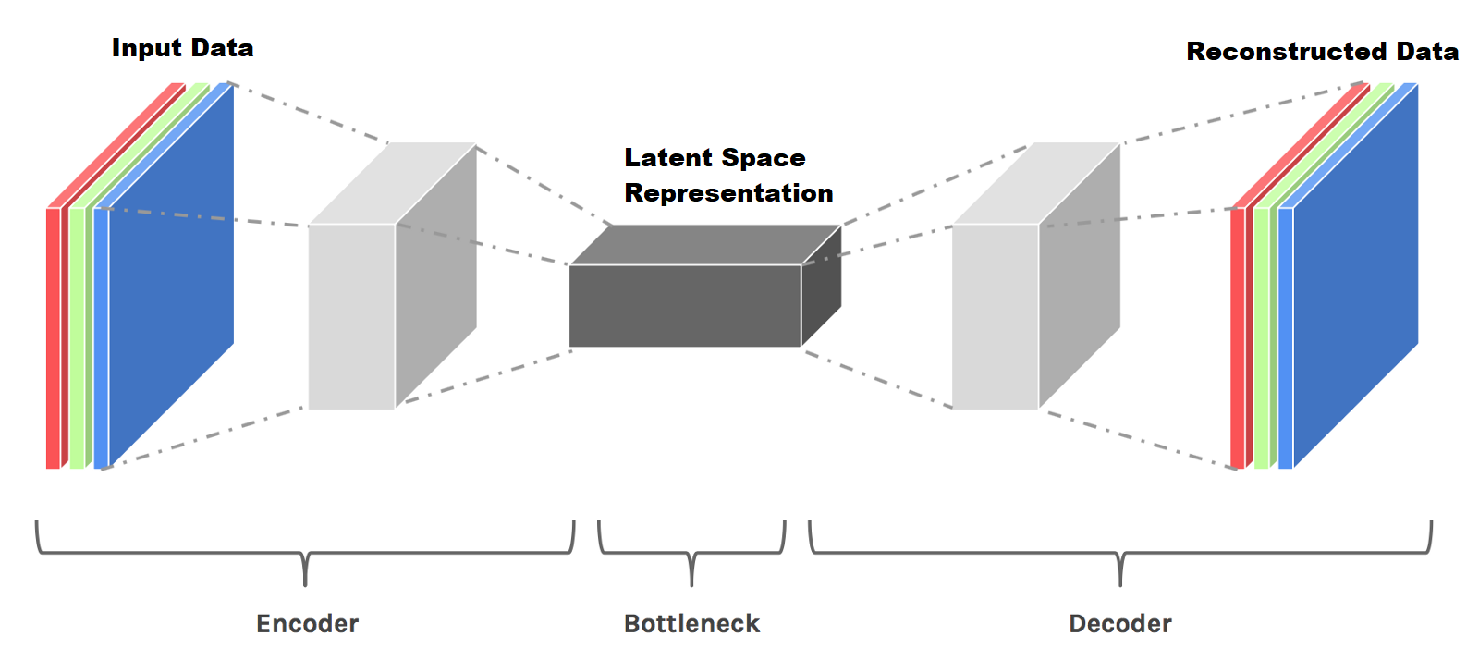
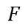
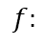
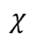
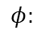


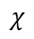

LSTM-based Autoencoder
LSTM network (a Deep Neural Network) is typically used for modelling sequence data, which efficiently handles the dependencies within a sequence.
The goal of the Autoencoder is to learn the time-series structure by minimizing the reconstruction error (the mean square error between input data and reconstructed data) for all the inputs.
$$f:$$
$$χ$$
$$→$$
$$χ$$
Input
Reconstructed Input
$$φ:$$
$$χ$$
$$→$$
$$F$$
$$ψ:$$
$$F$$
$$→$$
$$χ$$
Latent Space
$$L= {\left\|χ −(ψ ο φ)χ\right\|}^{2}$$
Reconstructed Error
Image Source: Google Image

Slide 50
First Step: Detecting the Anomaly
We collect performance counter data by sliding the observation window after each interval of 10ms and model the normal system behavior using an LSTM based Autoencoder.
Threshold is calculated by 3σ analysis on the reconstruction errors of normal behavior.

Slide 51
First Step: Detecting the Anomaly
We collect performance counter data by sliding the observation window after each interval of 10ms and model the normal system behavior using an LSTM based Autoencoder.
Threshold is calculated by 3σ analysis on the reconstruction errors of normal behavior.
Advantages of modeling normal behavior
We do not model the behavior of ransomware as there can be new ransomware at any point of time.
We do not need to label the dataset as any behavior higher than the normal behavior by a threshold can be treated as anomaly.

Slide 52
First Step: Detecting the Anomaly
We collect performance counter data by sliding the observation window after each interval of 10ms and model the normal system behavior using an LSTM based Autoencoder.
Threshold is calculated by 3σ analysis on the reconstruction errors of normal behavior.
Advantages of modeling normal behavior
We do not model the behavior of ransomware as there can be new ransomware at any point of time.
We do not need to label the dataset as any behavior higher than the normal behavior by a threshold can be treated as anomaly.
Intuition behind the anomaly detection
The Autoencoder is only shown the normal instances during the training phase and learned to reconstruct them.
When an anomalous sequence is given as an input to the Autoencoder, it will not be able to reconstruct it accurately, and hence would lead to higher reconstruction errors in comparison to the normal sequences.

Slide 53
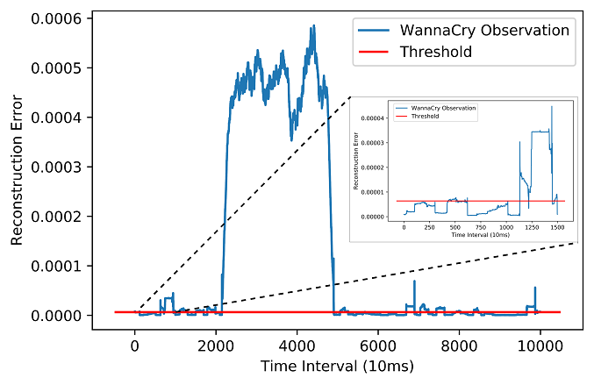
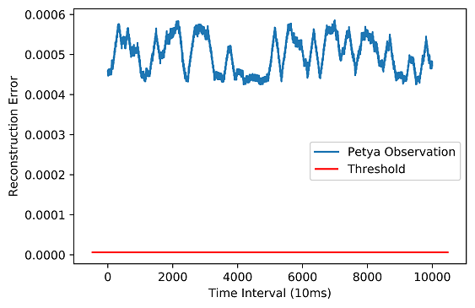
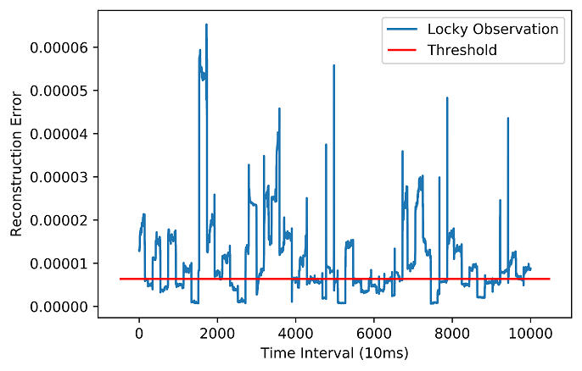
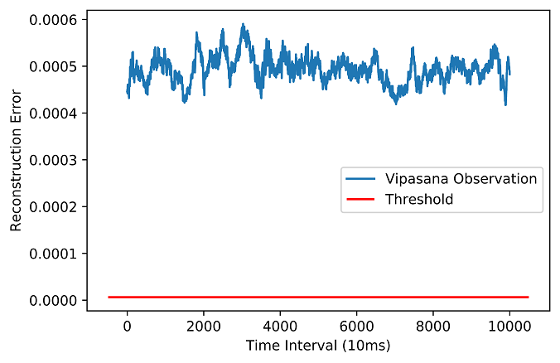
First Step: Detecting the Anomaly
We collect performance counter data by sliding the observation window after each interval of 10ms and model the normal system behavior using an LSTM based Autoencoder.
Threshold is calculated by 3σ analysis on the reconstruction errors of normal behavior.
Advantages of modeling normal behavior
We do not model the behavior of ransomware as there can be new ransomware at any point of time.
We do not need to label the dataset as any behavior higher than the normal behavior by a threshold can be treated as anomaly.
Intuition behind the anomaly detection
The Autoencoder is only shown the normal instances during the training phase and learned to reconstruct them.
When an anomalous sequence is given as an input to the Autoencoder, it will not be able to reconstruct it accurately, and hence would lead to higher reconstruction errors in comparison to the normal sequences.

Slide 54
How good is reconstruction error as a decider??
The analysis of different benign benchmark programs like: SPEC 2006, CHStone, UnixBench, LMBench show different results.

Slide 55
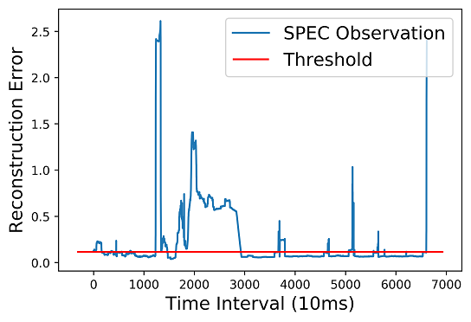
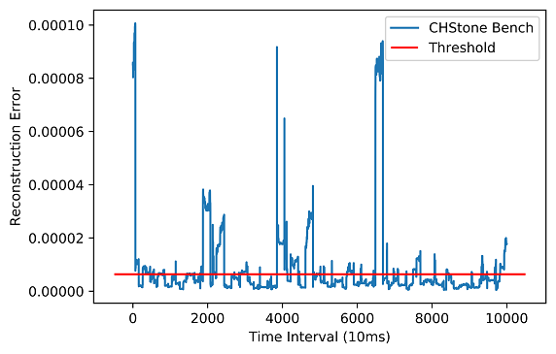
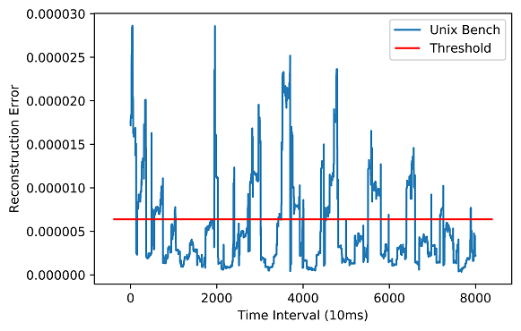
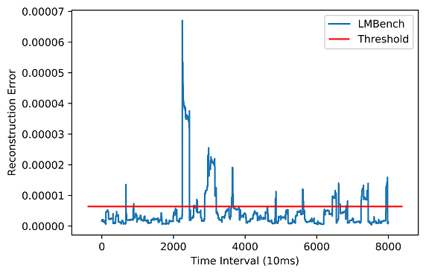
How good is reconstruction error as a decider??
The analysis of different benign benchmark programs like: SPEC 2006, CHStone, UnixBench, LMBench show different results.
The execution behavior of these benchmark suites are significantly different from the normal observations along with the ransomware programs.

Slide 56
How good is reconstruction error as a decider??
The analysis of different benign benchmark programs like: SPEC 2006, CHStone, UnixBench, LMBench show different results.
The execution behavior of these benchmark suites are significantly different from the normal observations along with the ransomware programs.
Only the reconstruction error is not enough for detecting Ransomware, since benign benchmark programs also act as anomalies.

Slide 57
Utilizing the fact of Repeated Encryption of Ransomwares
The Ransomware executable runs encryption repeatedly on multiple files.
We transform the traces of performance counter events from time domain to frequency domain using the Fast Fourier Transformation (FFT) to understand the repetitive pattern.

Slide 58
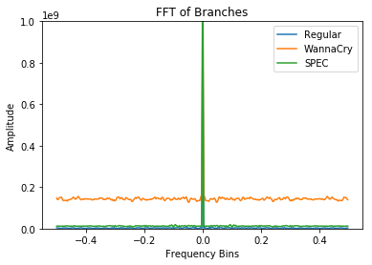
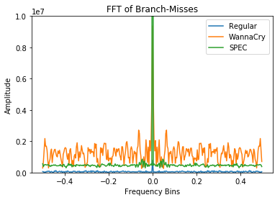
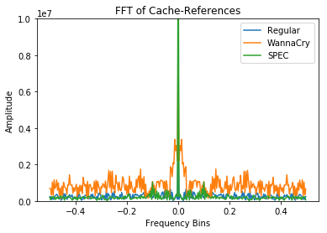
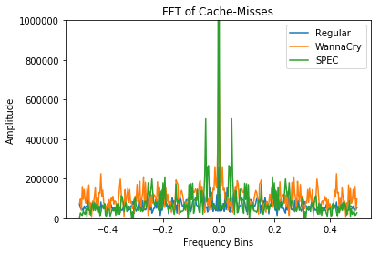
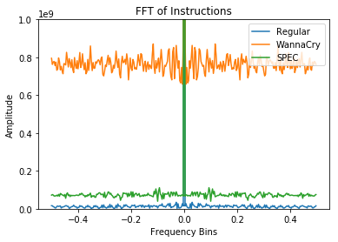
Utilizing the fact of Repeated Encryption of Ransomwares
The Ransomware executable runs encryption repeatedly on multiple files.
We transform the traces of performance counter events from time domain to frequency domain using the Fast Fourier Transformation (FFT) to understand the repetitive pattern.

Slide 59
Utilizing the fact of Repeated Encryption of Ransomwares
The Ransomware executable runs encryption repeatedly on multiple files.
We transform the traces of performance counter events from time domain to frequency domain using the Fast Fourier Transformation (FFT) to understand the repetitive pattern.
The transformation indicates that the amplitude for each frequency bins are constantly higher for the ransomware in contrary to the benchmark.

Slide 60
Second Step: Detecting Anomaly in Frequency Domain
Detecting Ransomwares
The variations of amplitudes for different frequency bins can be again considered as a time-series data, and another LSTM based autoencoder, as discussed before, can be used to detect the anomaly.
Threshold is calculated by 3σ analysis on the normal FFT behavior.

Slide 61
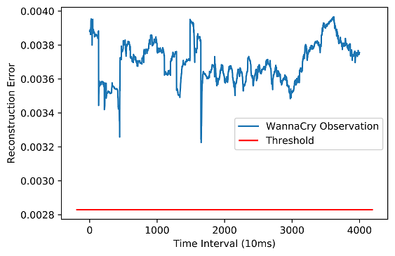
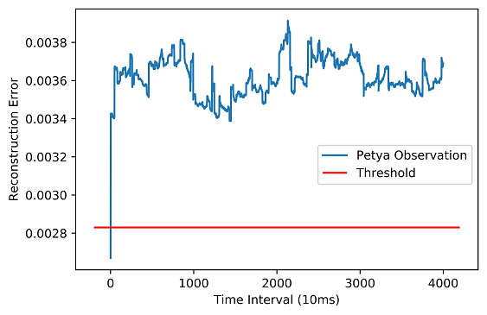
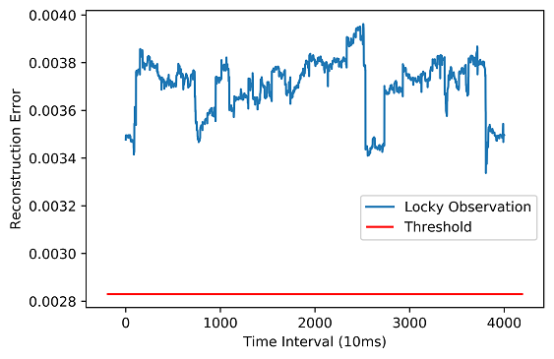
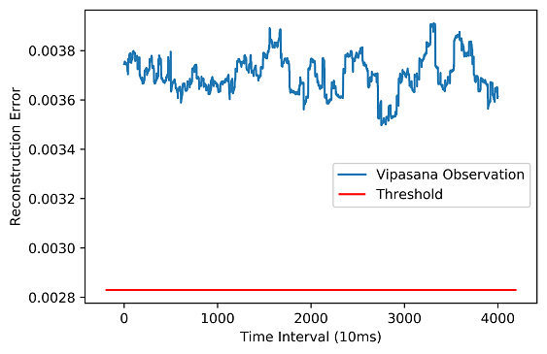
Second Step: Detecting Anomaly in Frequency Domain
Detecting Ransomwares
The variations of amplitudes for different frequency bins can be again considered as a time-series data, and another LSTM based autoencoder, as discussed before, can be used to detect the anomaly.
Threshold is calculated by 3σ analysis on the normal FFT behavior.

Slide 62
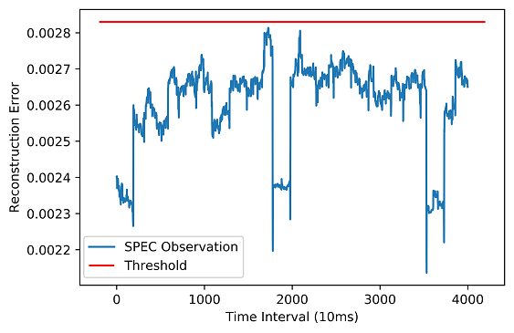
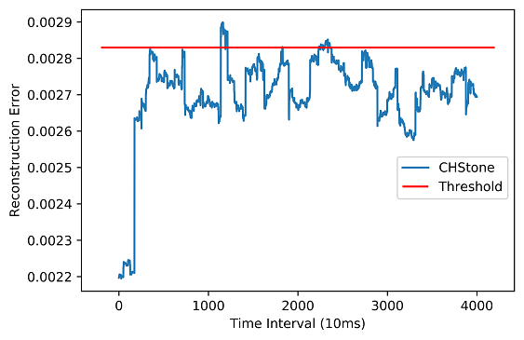
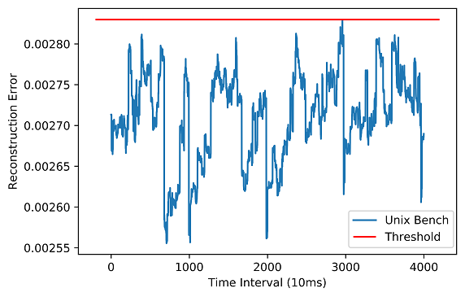
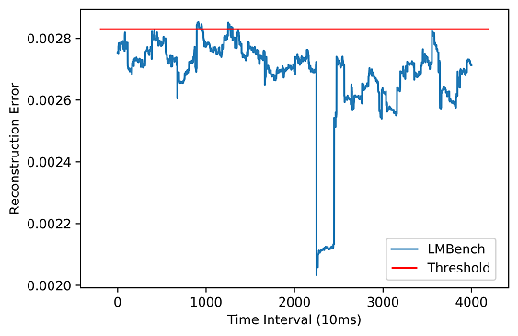
Second Step: Detecting Anomaly in Frequency Domain
Removing False Positives
The reconstruction errors of the benchmark programs always lie below the threshold.
We can hypothesize from this example that, if the reconstruction error in both the Autoencoders are constantly higher for some specific time we conclude that behavior as anomaly instead of considering a single peak.

Slide 63
Second Step: Detecting Anomaly in Frequency Domain
Removing False Positives
Need of both the Autoencoders
It is evident that the second Autoencoder is sufficient enough to discard the ransomwares.
The second Autoencoder takes the FFT converted values of the window data, and the FFT conversion requires some computational effort for the conversion.
Hence, to reduce the computational complexity of the detection framework, we apply a first level filter in terms of the first Autoencoder to remove the less computational heavy programs in the first stage itself and apply the FFT on the sequence data detected as an anomaly in the first stage before sending it to the second Autoencoder.
The reconstruction errors of the benchmark programs always lie below the threshold.
We can hypothesize from this example that, if the reconstruction error in both the Autoencoders are constantly higher for some specific time we conclude that behavior as anomaly instead of considering a single peak.

Slide 64
Difficulty for Disk Encryption Programs
Disk Encryption processes are very similar in operation to the malicious ransomware processes, though the intentions of the processes are entirely different.
Popular disk encryption processes like TrueCrypt and VeraCrypt are detected as ransomwares by the detection framework.

Slide 65
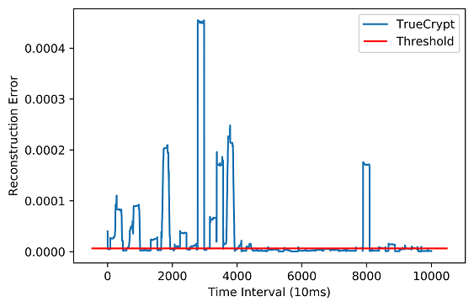
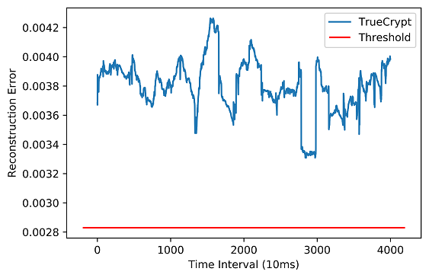
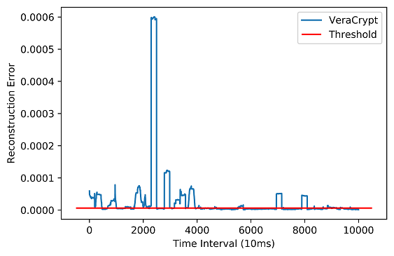
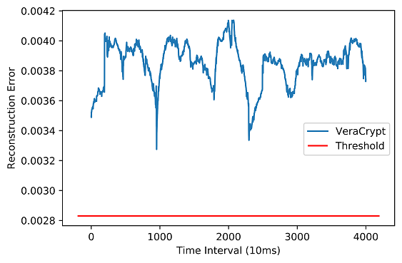
Difficulty for Disk Encryption Programs
Disk Encryption processes are very similar in operation to the malicious ransomware processes, though the intentions of the processes are entirely different.
Popular disk encryption processes like TrueCrypt and VeraCrypt are detected as ransomwares by the detection framework.
First Autoencoder
Second Autoencoder
First Autoencoder
Second Autoencoder

Slide 66
Difficulty for Disk Encryption Programs
Disk Encryption processes are very similar in operation to the malicious ransomware processes, though the intentions of the processes are entirely different.
Popular disk encryption processes like TrueCrypt and VeraCrypt are detected as ransomwares by the detection framework.
First Autoencoder
Second Autoencoder
One naive solution is to check the privilege of the current process under suspicion. Since the disk encryption processes can only be run by the administrator with the highest privilege.
First Autoencoder
Second Autoencoder

Slide 67
Third Step: Identifying Disk Encryption Process
All the popular disk encryption processes use AES-XTS mode of encryption [9, 10] for their operations.
We template the operation of a disk encryption process, and check for whether the suspicious program is a disk encryption process or not.
We calculate cumulative correlation over time for the suspicious process.
If the correlation is high for a successive interval of time, we conclude that the process is a disk encryption process.
M. V. Ball, C. Guyot, J. P. Hughes, L. Martin, and L. C. Noll, “The xts-aes disk encryption algorithm and the security of ciphertext stealing,” Cryptologia, vol. 36, no. 1, pp. 70–79, 2012.
L. Martin, “Xts: A mode of aes for encrypting hard disks,”IEEE Security& Privacy, vol. 8, no. 3, pp. 68–69, 2010.

Slide 68

Third Step: Identifying Disk Encryption Process
All the popular disk encryption processes use AES-XTS mode of encryption [9, 10] for their operations.
We template the operation of a disk encryption process, and check for whether the suspicious program is a disk encryption process or not.
We calculate cumulative correlation over time for the suspicious process.
If the correlation is high for a successive interval of time, we conclude that the process is a disk encryption process.
M. V. Ball, C. Guyot, J. P. Hughes, L. Martin, and L. C. Noll, “The xts-aes disk encryption algorithm and the security of ciphertext stealing,” Cryptologia, vol. 36, no. 1, pp. 70–79, 2012.
L. Martin, “Xts: A mode of aes for encrypting hard disks,”IEEE Security& Privacy, vol. 8, no. 3, pp. 68–69, 2010.

Slide 69
Third Step: Identifying Disk Encryption Process
All the popular disk encryption processes use AES-XTS mode of encryption [9, 10] for their operations.
We template the operation of a disk encryption process, and check for whether the suspicious program is a disk encryption process or not.
We calculate cumulative correlation over time for the suspicious process.
If the correlation is high for a successive interval of time, we conclude that the process is a disk encryption process.
What about Ransomwares having disk encryption as a subroutine? (MAMBA Ransomware)
M. V. Ball, C. Guyot, J. P. Hughes, L. Martin, and L. C. Noll, “The xts-aes disk encryption algorithm and the security of ciphertext stealing,” Cryptologia, vol. 36, no. 1, pp. 70–79, 2012.
L. Martin, “Xts: A mode of aes for encrypting hard disks,”IEEE Security& Privacy, vol. 8, no. 3, pp. 68–69, 2010.

Slide 70
Third Step: Identifying Disk Encryption Process
All the popular disk encryption processes use AES-XTS mode of encryption [9, 10] for their operations.
We template the operation of a disk encryption process, and check for whether the suspicious program is a disk encryption process or not.
We calculate cumulative correlation over time for the suspicious process.
If the correlation is high for a successive interval of time, we conclude that the process is a disk encryption process.
What about Ransomwares having disk encryption as a subroutine? (MAMBA Ransomware)
We temporary suspend the disk encryption program and wait for a confirmation from the user whether the suspected program is actually launched by the user.
M. V. Ball, C. Guyot, J. P. Hughes, L. Martin, and L. C. Noll, “The xts-aes disk encryption algorithm and the security of ciphertext stealing,” Cryptologia, vol. 36, no. 1, pp. 70–79, 2012.
L. Martin, “Xts: A mode of aes for encrypting hard disks,”IEEE Security& Privacy, vol. 8, no. 3, pp. 68–69, 2010.

Slide 71
Methodology

Slide 72
Methodology
Offline Phase

Slide 73
Methodology
Normal Observation
Watchdog Program
Offline Phase

Slide 74
Methodology
Normal Observation
Watchdog Program
Autoencoder_1
FFT Module
Offline Phase

Slide 75
Methodology
Normal Observation
Watchdog Program
Autoencoder_1
FFT Module
Offline Phase
Autoencoder_2

Slide 76
Methodology
Disk Encryption
Watchdog Program
Autoencoder_1
FFT Module
Offline Phase
Autoencoder_2

Slide 77
Methodology
Disk Encryption
Watchdog Program
Autoencoder_1
FFT Module
Offline Phase
Autoencoder_2

Slide 78
Methodology
Disk Encryption
Watchdog Program
Autoencoder_1
FFT Module
Offline Phase
Autoencoder_2

Slide 79
Methodology
Disk Encryption
Watchdog Program
Autoencoder_1
FFT Module
Offline Phase
Autoencoder_2
Correlation Module

Slide 80
Methodology
Watchdog Program
Autoencoder_1
FFT Module
Online Phase
Autoencoder_2
Correlation Module

Slide 81
Methodology
Unknown Process
Watchdog Program
Autoencoder_1
FFT Module
Online Phase
Autoencoder_2
Correlation Module

Slide 82
Methodology
Unknown Process
Watchdog Program
Autoencoder_1
FFT Module
Online Phase
Autoencoder_2
Correlation Module

Slide 83

Methodology
Unknown Process
Watchdog Program
Autoencoder_1
FFT Module
Error >
$$R_{t}$$
Online Phase
Autoencoder_2
Correlation Module

Slide 84
Methodology
Unknown Process
Watchdog Program
Autoencoder_1
FFT Module
Error >
$$R_{t}$$
Online Phase
True
Autoencoder_2
Correlation Module

Slide 85
Methodology
Unknown Process
Watchdog Program
Autoencoder_1
FFT Module
Error >
$$R_{t}$$
Online Phase
True
Autoencoder_2
Correlation Module

Slide 86
Methodology
Unknown Process
Watchdog Program
Autoencoder_1
FFT Module
Error >
$$R_{t}$$
Online Phase
True
Autoencoder_2
Correlation Module

Slide 87

Methodology
Unknown Process
Watchdog Program
Autoencoder_1
FFT Module
Error >
$$R_{t}$$
Online Phase
True
Autoencoder_2
Error >
$$R_{t}^{′}$$
Correlation Module

Slide 88
Methodology
Unknown Process
Watchdog Program
Autoencoder_1
FFT Module
Error >
$$R_{t}$$
Online Phase
True
Autoencoder_2
Error >
$$R_{t}^{′}$$
True
Correlation Module

Slide 89
Methodology
Unknown Process
Watchdog Program
Autoencoder_1
FFT Module
Error >
$$R_{t}$$
Online Phase
True
Autoencoder_2
Error >
$$R_{t}^{′}$$
Low Correlation
True
Correlation Module
Ransomware Process

Slide 90
Methodology
Unknown Process
Watchdog Program
Autoencoder_1
FFT Module
Error >
$$R_{t}$$
Online Phase
True
Autoencoder_2
Error >
$$R_{t}^{′}$$
High Correlation
True
Correlation Module
Wait for Confirmation

Slide 91
Performance of the Method
Detection Time (in Seconds)
Comparison of with State-of-the-Art
WannaCry | Petya | Locky | Vipasana
5.313 | 1.203 | 3.123 | 1.003
Kharraz et al. [2] | Mercaldo et al. [3] | C. Moore [4] | Scaife et al. [5] | Proposed Method
Did not consider evaluation on computationally intensive benchmark programs explicitly |  |  |  | Can differentiate from Ransomwares
Did not considered Disk Encryption Programs for false +ve evaluation | Did not considered Disk Encryption Programs for false +ve evaluation | False Negative for some ransomwares | Needs Kernel Modification | Can detect Disk Encryption Programs as false positives without any Kernel Modification

Slide 92
Discussion on File Recovery
As a sample run with the WannaCry, out of 10000 files of approximately 21 bytes each, when the proposed method stops its execution, 68 files are encrypted.
Depending on the detection latency, the ransomware can encrypt few files (say n).
A practical solution would be to take backups of the n-recently opened files. After the lapse of the time quantum required to encrypt these files, we delete the copies if no ransomware alarm is raised by RAPPER.
This minimizes the storage necessary for the backup files.
To further ensure that the backup files are not encrypted we perform locking operation, like in Linux using mlock().

Slide 93

Discussion on File Recovery
As a sample run with the WannaCry, out of 10000 files of approximately 21 bytes each, when the proposed method stops its execution, 68 files are encrypted.
Depending on the detection latency, the ransomware can encrypt few files (say n).
A practical solution would be to take backups of the n-recently opened files. After the lapse of the time quantum required to encrypt these files, we delete the copies if no ransomware alarm is raised by RAPPER.
This minimizes the storage necessary for the backup files.
To further ensure that the backup files are not encrypted we perform locking operation, like in Linux using mlock().
Image Source: Google Image

Slide 94

Discussion on File Recovery
As a sample run with the WannaCry, out of 10000 files of approximately 21 bytes each, when the proposed method stops its execution, 68 files are encrypted.
Depending on the detection latency, the ransomware can encrypt few files (say n).
A practical solution would be to take backups of the n-recently opened files. After the lapse of the time quantum required to encrypt these files, we delete the copies if no ransomware alarm is raised by RAPPER.
This minimizes the storage necessary for the backup files.
To further ensure that the backup files are not encrypted we perform locking operation, like in Linux using mlock().
mlock()
Image Source: Google Image

Slide 95

Discussion on File Recovery
As a sample run with the WannaCry, out of 10000 files of approximately 21 bytes each, when the proposed method stops its execution, 68 files are encrypted.
Depending on the detection latency, the ransomware can encrypt few files (say n).
A practical solution would be to take backups of the n-recently opened files. After the lapse of the time quantum required to encrypt these files, we delete the copies if no ransomware alarm is raised by RAPPER.
This minimizes the storage necessary for the backup files.
To further ensure that the backup files are not encrypted we perform locking operation, like in Linux using mlock().
mlock()
Image Source: Google Image

Slide 96
Discussion on File Recovery
As a sample run with the WannaCry, out of 10000 files of approximately 21 bytes each, when the proposed method stops its execution, 68 files are encrypted.
Depending on the detection latency, the ransomware can encrypt few files (say n).
A practical solution would be to take backups of the n-recently opened files. After the lapse of the time quantum required to encrypt these files, we delete the copies if no ransomware alarm is raised by RAPPER.
This minimizes the storage necessary for the backup files.
To further ensure that the backup files are not encrypted we perform locking operation, like in Linux using mlock().
mlock()
Image Source: Google Image

Slide 97
Conclusion
We present a detailed understanding of the effect of ransomware on normal system behavior.
We take the aid of the Deep Neural Network to detect the presence of ransomwares using a three-step detection framework.
The entire detection procedure does not require any template of ransomware programs beforehand. Instead, it thrives on an anomaly detection procedure to detect the infectious ransomwares in as less as 5 seconds with almost zero false positives, using frequency analysis.
We also discussed one simple yet efficient method for file recovery which gets encrypted by a ransomware before its detection.

Slide 98
THANK YOU FOR YOUR ATTENTION!
Any questions?

